Slide 1

D. Y. PATIL COLLEGE OF ENGINEERING, AKURDI, PUNE-44
Department of Artificial Intelligence & Data Science
BE Project Stage - I (A.Y. 2023-24 SEM VII)
Presentation On
Smart Plant Care System
For
Farming & Gardening
Guide - Mrs.M.D.Karajgar

Slide 2
Presented By Group No :-30
Chaitanya
Vyavhare
BEAIDA39
Radhika
Marda
BEAIDA37
Samiksha
Kamble
BEAIDA47
Maitri
Jadhav
BEAIDA25

Slide 3
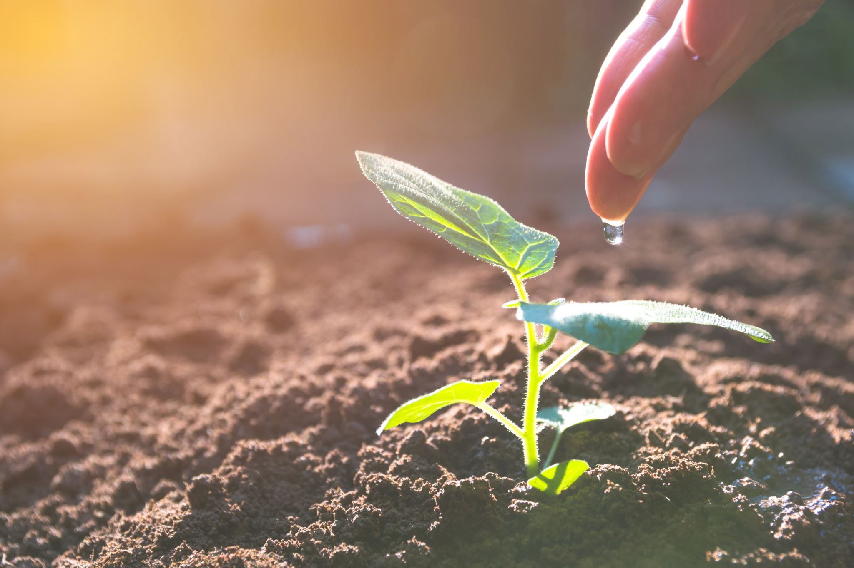
Problem Statement
Developing an automated irrigation system with IoT technology to improve agricultural output, save labor expenses, and optimize water use in Indian agriculture while solving issues with human error, expensive maintenance, and dependence on unpredictable rainfall.

Slide 4

Introduction
The Internet of Things (IoT) has transformed our world, enabling interaction with physical objects via sensors and software. This project leverages IoT to develop an automated irrigation system for Indian farms. Using a DHT11 sensor, it measures environmental factors like temperature and humidity, and adjusts irrigation through a machine-learning algorithm. The system also analyzes soil conditions, suggests suitable crops, and detects plant diseases using a Convolutional Neural Network. Unlike manual irrigation, which is prone to errors, time-consuming, and dependent on rainfall, this automated system conserves water and reduces labor, promoting efficient and sustainable farming.

Slide 5

Why we chose this topic?
In today's busy world, we forget to nourish and water plants that makes our home clean and soothing.
Think about it what if your plants are able to tell you when they are happy and when they require proper attention.
It would be awesome right! It would be really helpful if we get a notification on our phones about our plant's health and needs.

Slide 6

IoT Plant monitoring system will check the moisture content of the soil and intensity of sunlight falling on plant at regular time intervals.
Based on the Soil moisture level motor will automatically turn on and off or we can manually set the limit and turn on and of the motor.
Detecting plant disease just by uploading a photo and proper treatment
So what is the solution?

Slide 7
Algorithm
Used
Decision Tree
CNN

Slide 8
Software Used
Firebase
Streamlit

Slide 9

Hardware Used
Nodemcu board
DHT11 sensor
Jumper cables
Soil moisture sensor
DC water pump
Relay
Battery

Slide 10
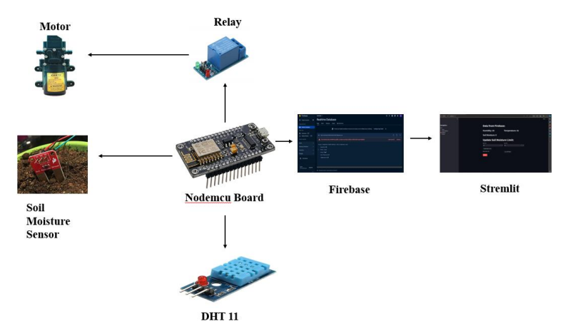
Set Up

Slide 11

Hardware Connections:
ESP8266: Connect ESP8266 to Wi-Fi network for internet connectivity.Configure GPIO pins for sensor and relay connections.
01
DHT11 Sensor: Connect the DHT11 sensor's data pin to GPIO 2 of the ESP8266.
02
Soil Moisture Sensor: Connect the soil moisture sensor's data pin to analog pin A0 of the ESP8266.
03
Relay: Connect the relay to GPIO pin D1 of the ESP8266 to control the water pump motor.
04
12-Volt Battery: Connect the 12-volt battery to power the water pump motor.
05

Slide 12
Implementation

Slide 13
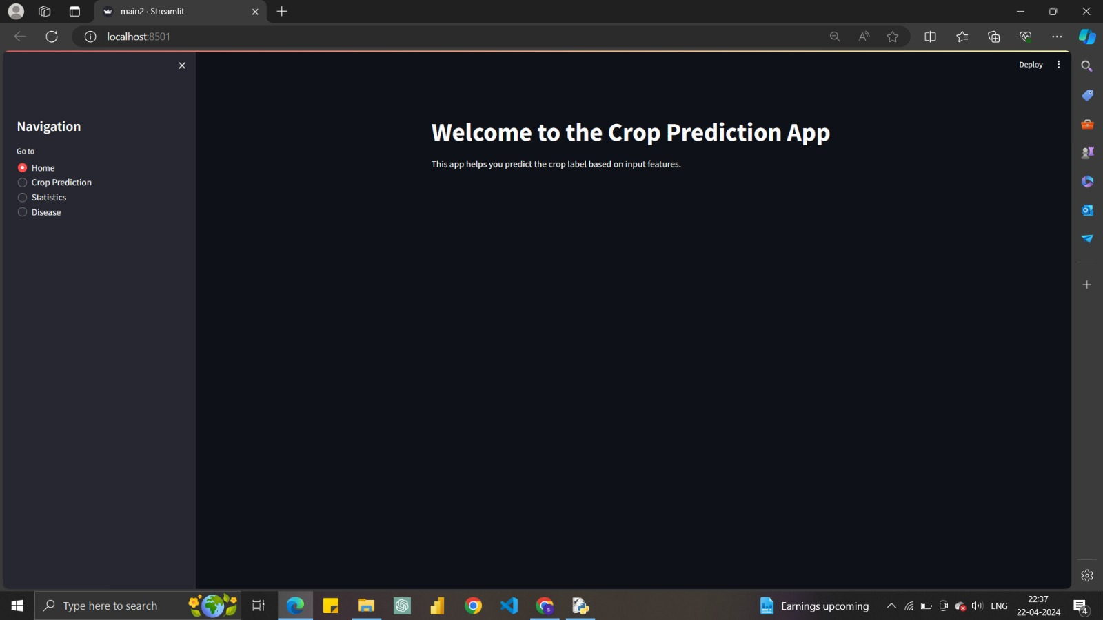
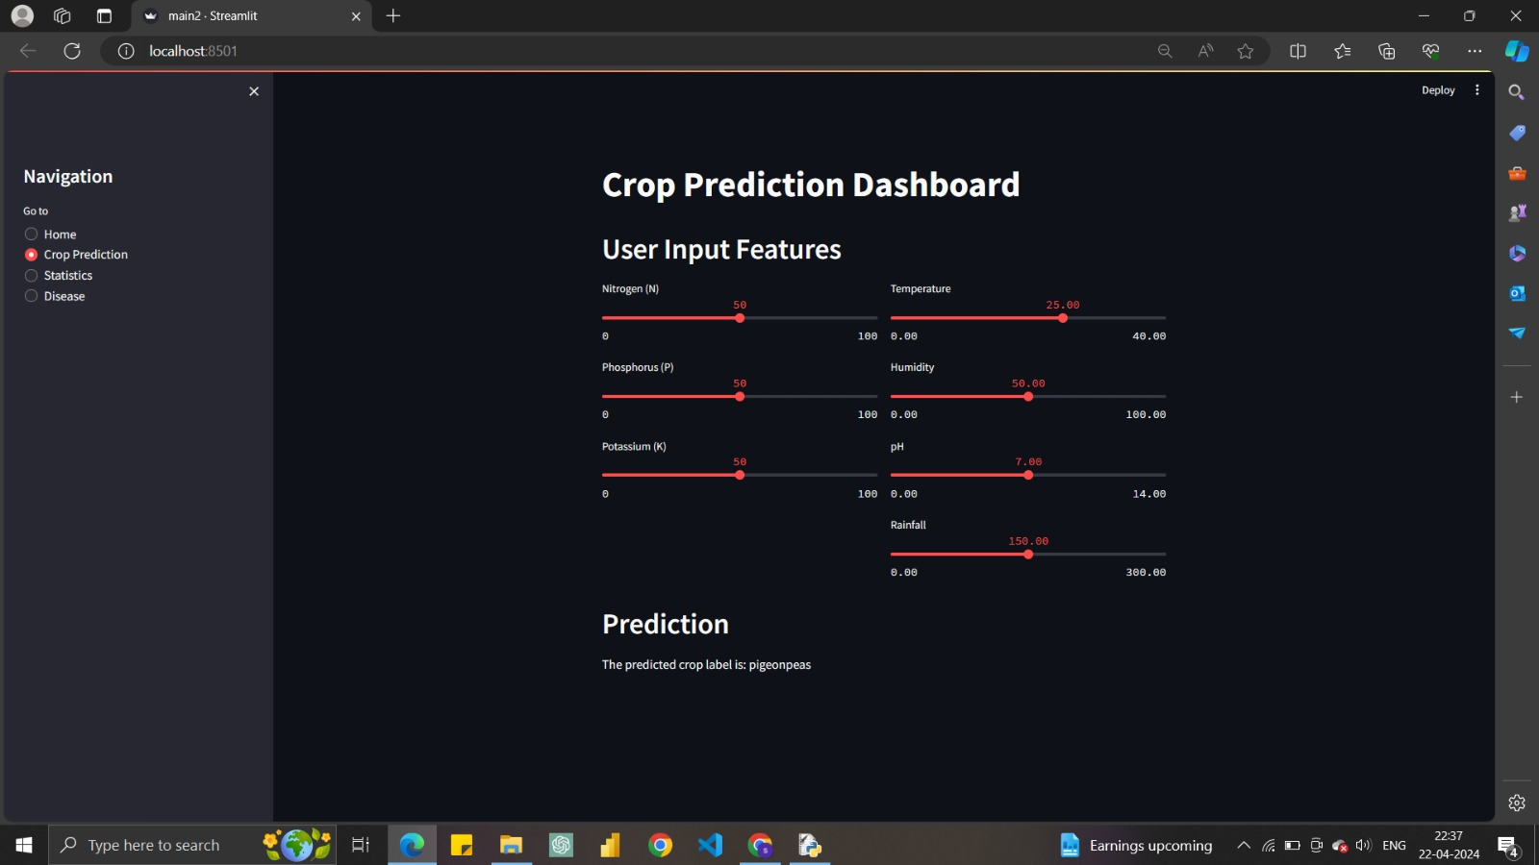

Slide 14
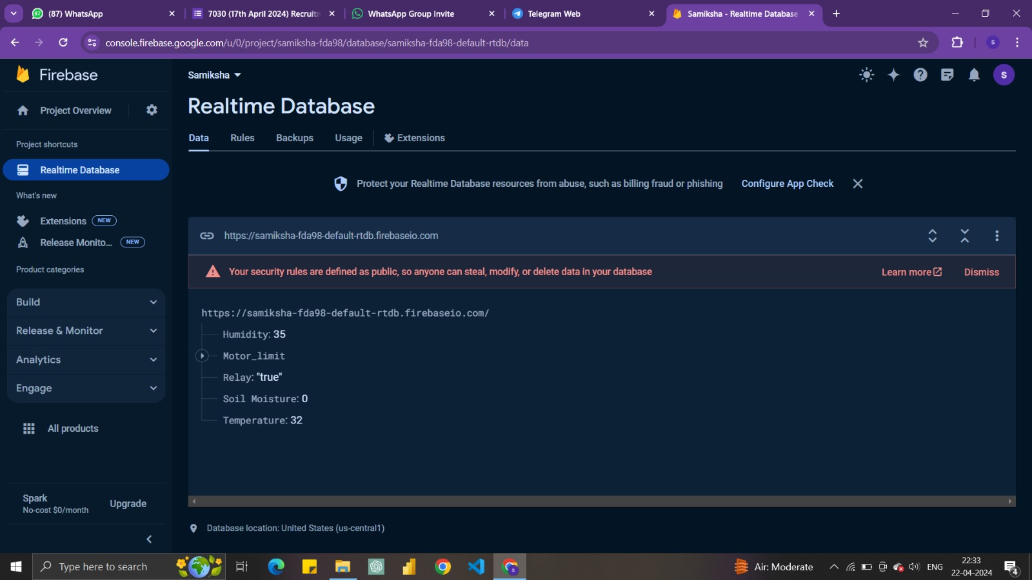
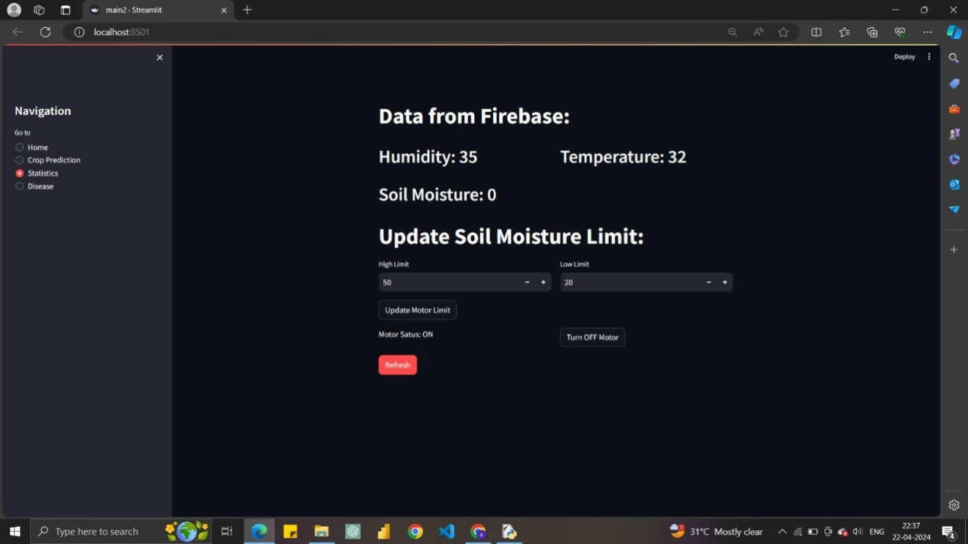

Slide 15
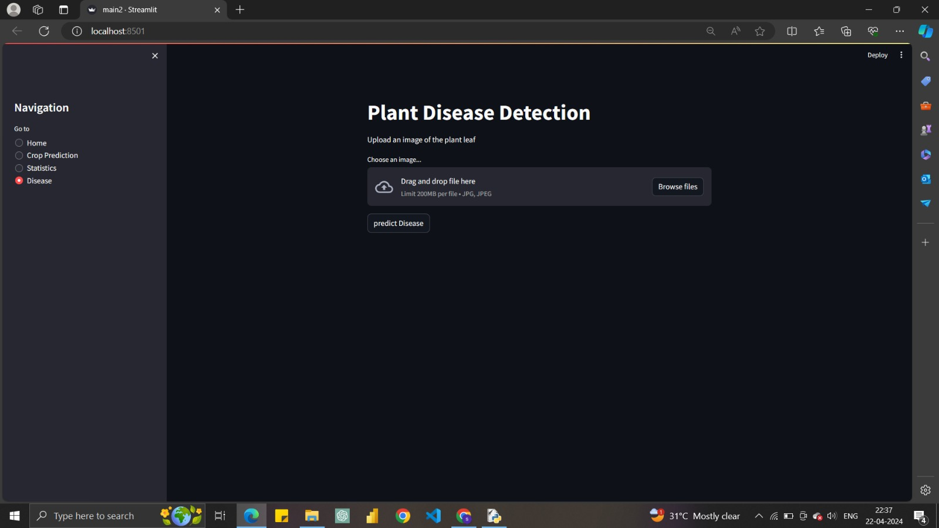
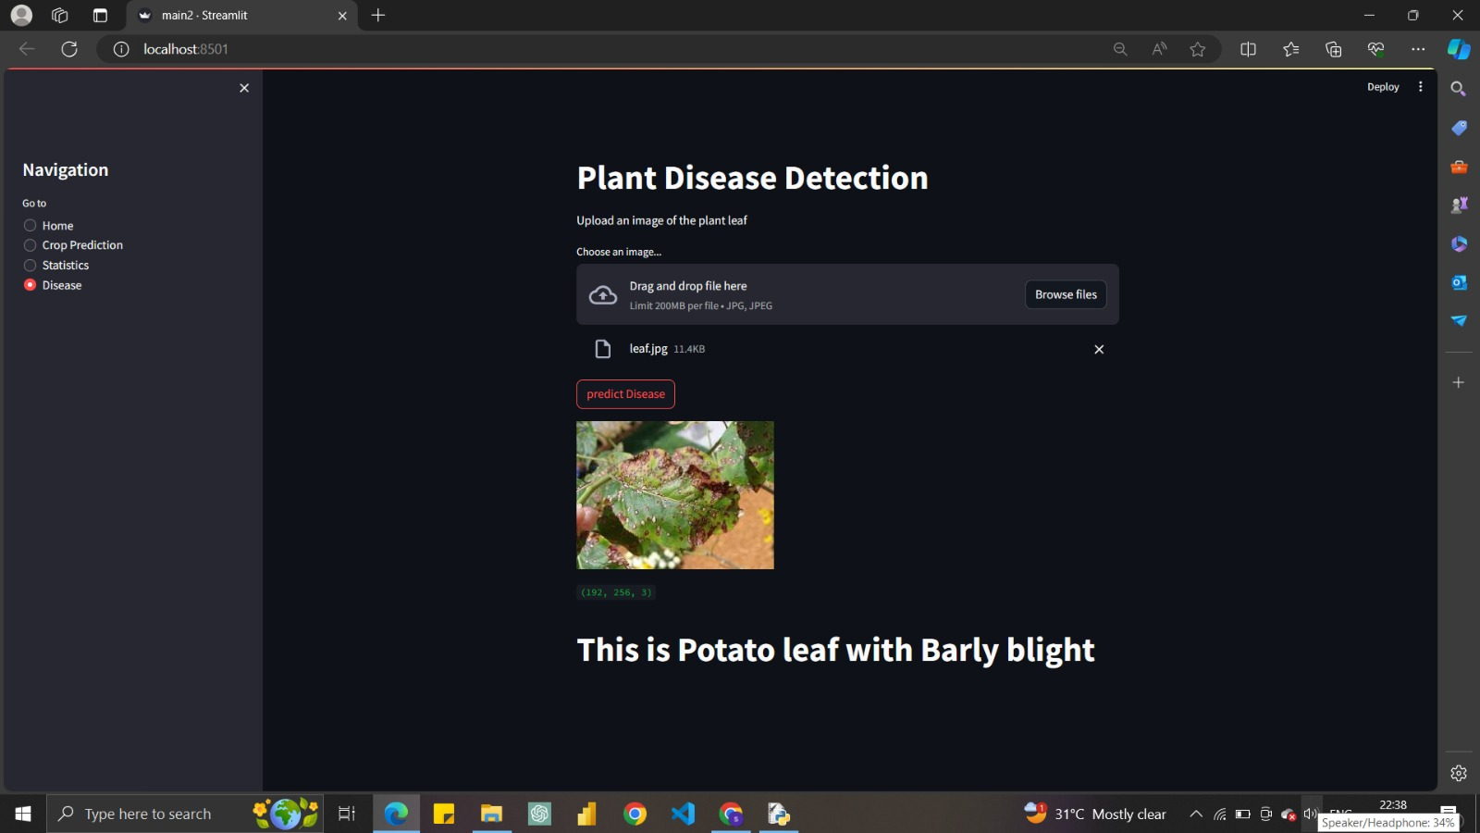

Slide 16
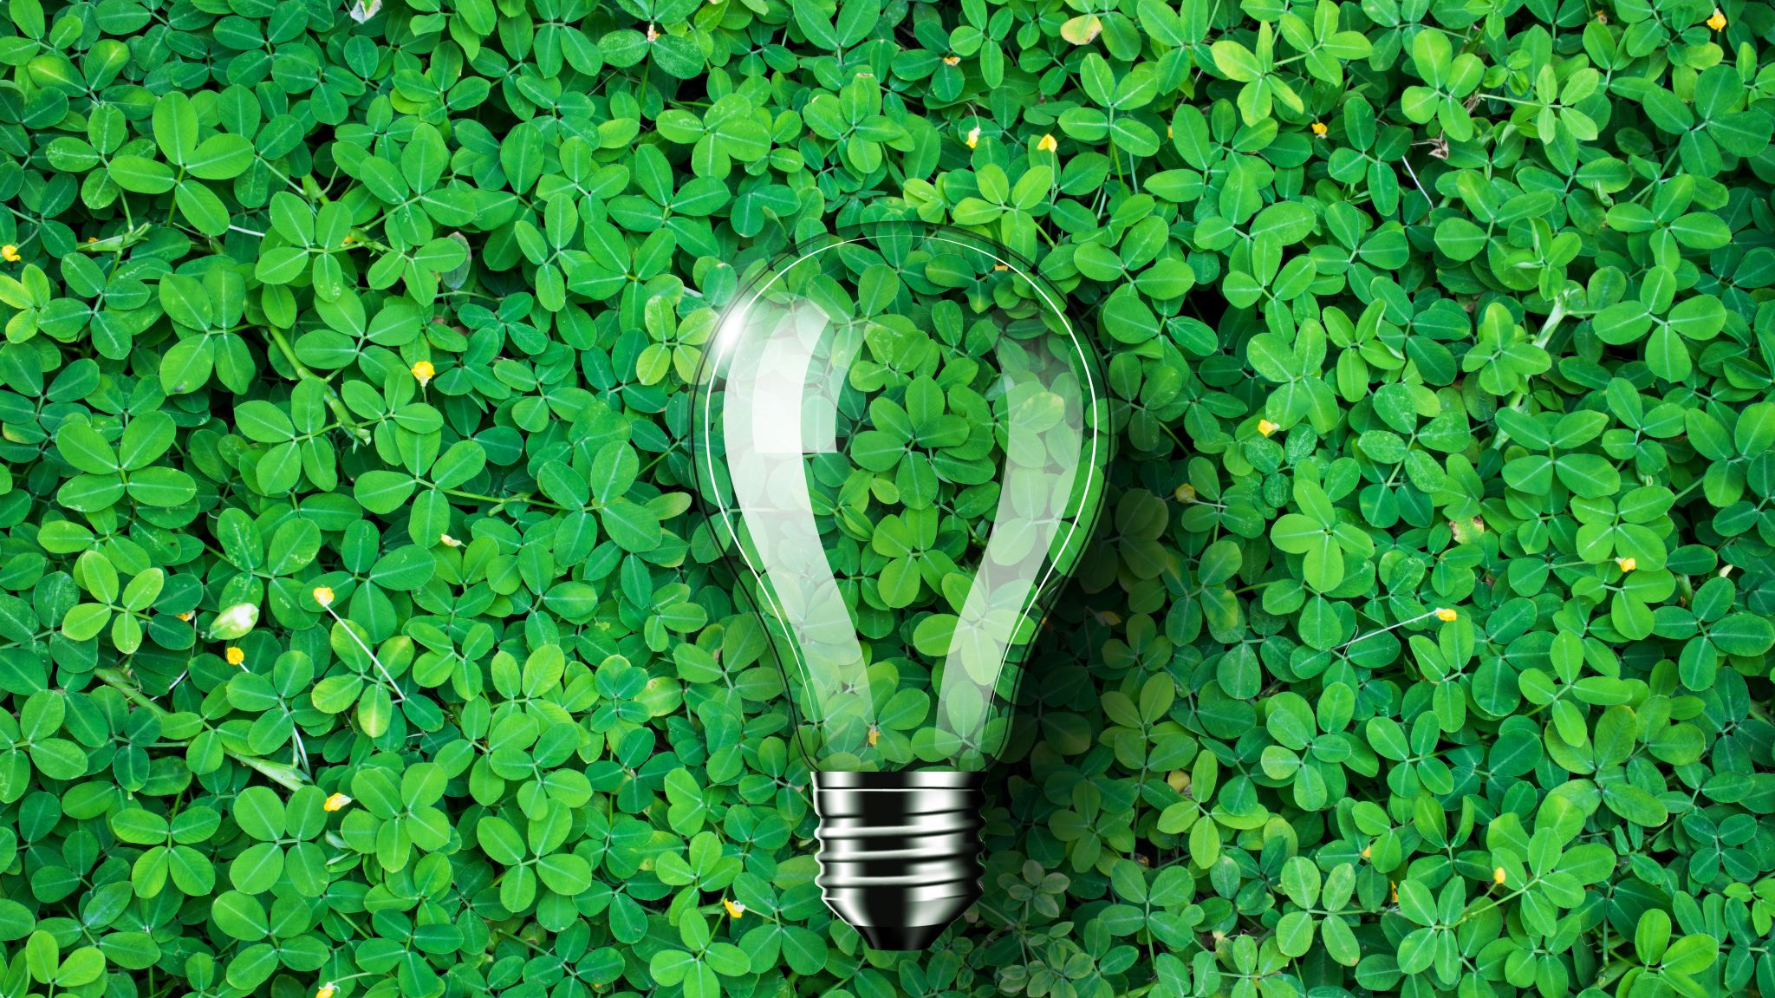
Conclusion
In summary, our smart plant care system revolutionizes farming and gardening with precise soil analysis, plant disease monitoring, and efficient watering. It empowers users with informed cultivation decisions, promotes plant health, conserves water, and optimizes yields, offering a comprehensive solution for sustainable and efficient plant care.

Slide 17

Future Scope
Use
Use the Arduino boards or Raspberry Pi.
Wireless
Wireless Connections
Link
link Multiple Machines to Arduino boards
Detect
Detect Plant Disease in real time.
Provide
Provide Precautions.

Slide 18
Thank you

